Slide 1
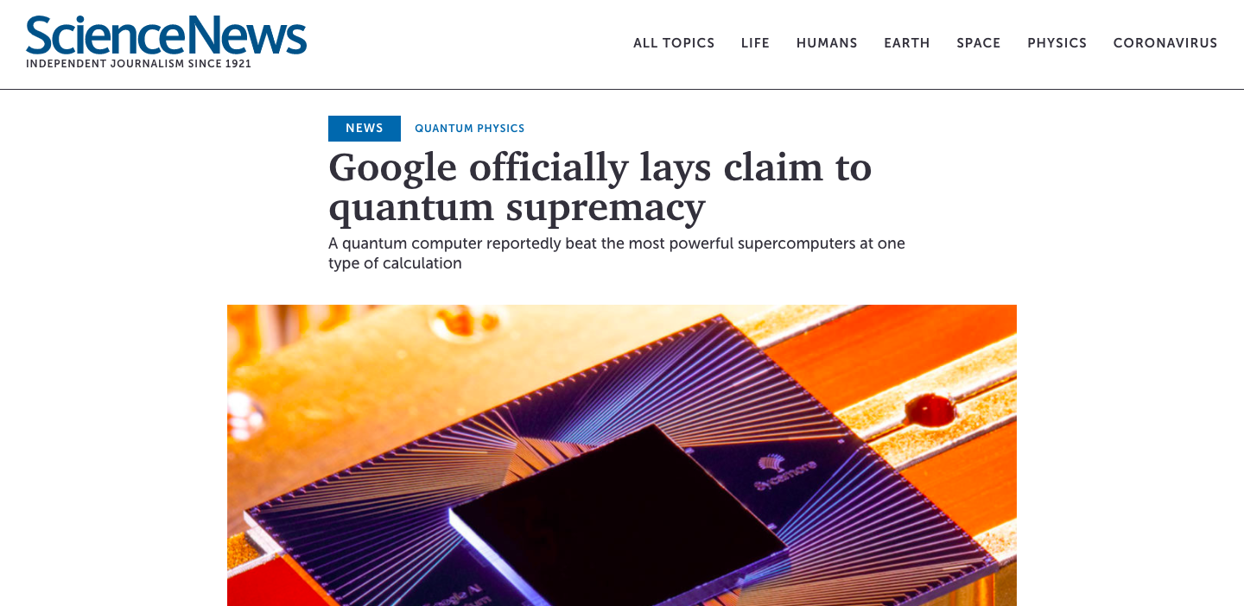
Notes:
Just last year, Google announced a huge milestone in the quantum computing research field. It demonstrated the ability for its quantum computer to complete a task that takes a classical computer 10,000 years to complete, in a mere 200 seconds. This quantum supremacy brought up a lot of commotion and controversy!
https://www.sciencenews.org/article/google-quantum-computer-supremacy-claim

Slide 2

Emerging Technologies: Quantum Computers
Jaimil Dalwadi
Notes:
Today, I would like to talk about the emerging technology – Quantum Computers!

Slide 3
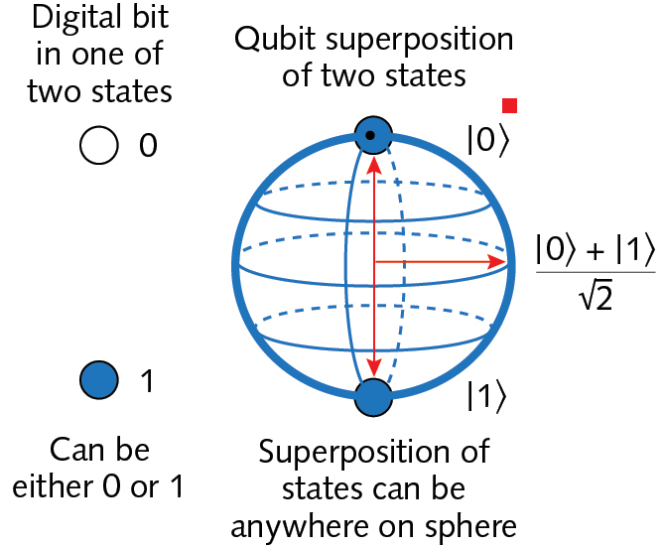
General Description
Notes:
Quantum computers are so unique because they are fundamentally different from classical computers. Classical computers use transistors to calculate and do tasks. These transistors can be either on or off, which leads to the binary language which computers understand (base 2, 0’s and 1’s). To represent data, classical computers use bits which can be either 1 or 0. Through intensive research, scientists have found ways to implement quantum mechanics into computing and use the qubit for quantum computing. The qubit can also hold values like the bit. It can be 1 or 0; however, it can also be anywhere in between (known as superposition). This would likely be a probability value such as 70% 1 and 30% 0. By being able to store all these different values in a single qubit, quantum computers can process large amounts of data much more efficiently. This makes specific tasks much easier for a quantum computer to process compared to a classical computer; such as the task that Google simulated.
https://www.wired.com/story/wired-guide-to-quantum-computing/ for information
https://img.laserfocusworld.com/files/base/ebm/lfw/image/2020/07/2006LFW_jh2_z01.5f05deefdb870.png?auto=format&fit=max&w=1200 for image

Slide 4
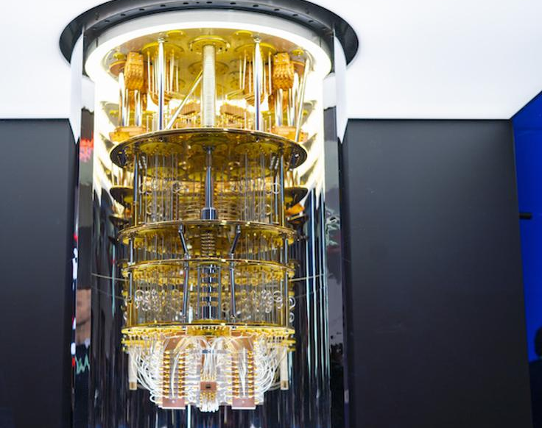
IBM Quantum Computer
Notes:
Here is an example of a quantum computer, at IBM. Its name is IBM Q System One. As you can see, it requires a huge amount of space, a surrounding refrigerator to keep the environment stable for qubits to achieve superposition.
https://specials-images.forbesimg.com/imageserve/5e1c9a33a854780006e868cc/960x0.jpg?fit=scale

Slide 5
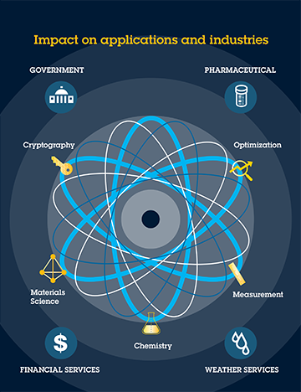
Notes:
Like classical computers, quantum computers are expected to impact several industries and revolutionize the way we live our lives. Some direct impacts that are foreseen now include government, pharmaceutical industries, financial services such as banking, weather services, and many more. Quantum computers can efficiently simulate hundreds of different drug/protein solutions in chemistry compared to classical computers. Quantum computers can encrypt data in much safer methods and crack regularly encoded data much more efficiently as well. By creating simulations based on real world physics (quantum mechanics), these computers can accurately predict weather patterns. Through efficient database searching, encryption, sorting, and other methods, financial services can be drastically improved. There are many more applications such as defense systems for governments, gene editing, the Internet, healthcare, energy sources, and many more. These are the direct applications of quantum computing now; however, there are many outcomes that we may not predict at the moment. Quantum processing could be applied to our daily lives, just like classical computing at some point in the future.
https://blog.usejournal.com/quantum-computing-the-basics-the-bad-and-the-solution-59af357fb52 for image
https://www.dwavesys.com/quantum-computing/industries for information

Slide 6

Complete Access – Open Source
Notes:
This technology is available for everyone to use through open source systems such as IBM’s Quantum Experience, D-Wave’s commercial use quantum processors, and many more. Quantum processors require very stable and delicate environments; thus, they can not be used in classical computers just yet. To tackle this challenge, the field has diverted to cloud computing to provide accessibility to a quantum computer for any person with a device with access to the Internet. The Quantum Open Source Foundation monitors and provides a list of open source textbooks, courses, quantum simulators, and companies for everyone. Most businesses in the industries mentioned earlier would benefit greatly from the use of quantum applications, but everyday users can also create unique applications to tailor to their own needs.
https://qosf.org/project_list/
https://static.wixstatic.com/media/be812b_8f71c1657d61451796bca30c1413100a~mv2.jpg for image

Slide 7
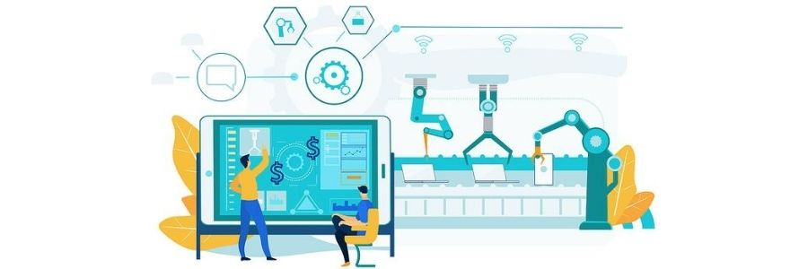
Costs
Notes:
Since this technology is still emerging and the hardware related to it is extremely complex, quantum computers require a ton of money to develop and improve. D-Wave valued its first commercial quantum computer at $10 million. Other sources mention that developing a single qubit can be approximately $10,000. Creating a fully applicable quantum computer in the future is estimated to cost approximately $10 billion. Even though the development is expensive, it is expected to reduce energy consumption by 10-100 times, and the market is expected to reach $60 billion by 2030 even though it is only $500 million as of 2019.
https://arxiv.org/abs/1609.02732
https://www.globenewswire.com/news-release/2020/04/06/2011932/0/en/Worldwide-Quantum-Computing-Market-2019-to-2030-Drivers-Restraints-and-Opportunities.html
https://www.technologyreview.com/2020/02/26/916744/quantum-computer-race-ibm-google/#:~:text=The%20first%20working%2012%2Dqubit%20quantum%20computer.&text=D%2DWave%20releases%20the%20first,It%20costs%20%2410m.
https://www.theguardian.com/technology/2019/aug/02/quantum-supremacy-computers
https://s3.amazonaws.com/pas-wordpress-media/content/uploads/2018/07/29224559/LivePlan-Headers-3.jpg for image

Slide 8
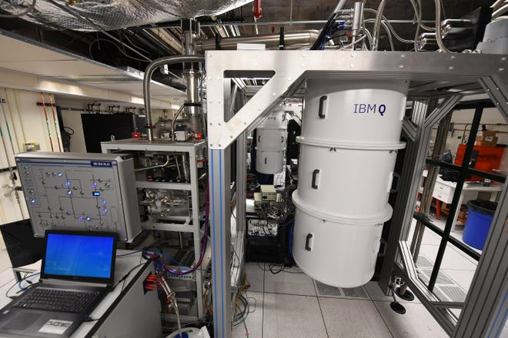
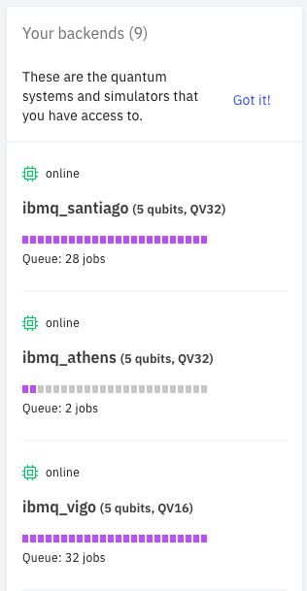

Problems and Limits
Notes:
-Queues
Quantum computing is still running off the cloud which means that users must share quantum computers. This limits the user’s ability to run the task as soon as possible. Several queues are made for each type of quantum computer as seen in IBM’s quantum experience simulator from my personal account.
-Complex Environments
As seen in the image, quantum computers require very complex environments to achieve superposition. They are not portable and so, the use is limited to virtual until further research is done.
https://www.gannett-cdn.com/presto/2020/03/02/USAT/d80535f0-1a54-48b8-af16-272cb40d4385-XXX_IBM_Research_rd177.JPG?width=660&height=440&fit=crop&format=pjpg&auto=webp for image
-Limits to the Types of Problems
Quantum computers aren’t made to replace classical computers, but rather, to solve a different type of complex problems that classical computers can’t solve. Generally speaking, classical computers will be better at computing certain daily tasks than quantum computers.
https://bernardmarr.com/default.asp?contentID=1193
https://scx2.b-cdn.net/gfx/news/2019/5cadd3960cba8.jpg for image

Slide 9

Thank You For Listening
I hope you learned and got a basic understanding of quantum computers

